Slide 1
Chapter 5 Methods

Slide 2
Opening Problem
Find the sum of integers from 1 to 10, from 20 to 30, and from 35 to 45, respectively.

Slide 3
Problem
int sum = 0;
for (int i = 1; i <= 10; i++)
sum += i;
System.out.println("Sum from 1 to 10 is " + sum);
sum = 0;
for (int i = 20; i <= 30; i++)
sum += i;
System.out.println("Sum from 20 to 30 is " + sum);
sum = 0;
for (int i = 35; i <= 45; i++)
sum += i;
System.out.println("Sum from 35 to 45 is " + sum);

Slide 4
Problem
int sum = 0;
for (int i = 1; i <= 10; i++)
sum += i;
System.out.println("Sum from 1 to 10 is " + sum);
sum = 0;
for (int i = 20; i <= 30; i++)
sum += i;
System.out.println("Sum from 20 to 30 is " + sum);
sum = 0;
for (int i = 35; i <= 45; i++)
sum += i;
System.out.println("Sum from 35 to 45 is " + sum);

Slide 5
Solution
public static int sum(int i1, int i2) {
int sum = 0;
for (int i = i1; i <= i2; i++)
sum += i;
return sum;
}
public static void main(String[] args) {
System.out.println("Sum from 1 to 10 is " + sum(1, 10));
System.out.println("Sum from 20 to 30 is " + sum(20, 30));
System.out.println("Sum from 35 to 45 is " + sum(35, 45));
}

Slide 6

Defining Methods
A method is a collection of statements that are grouped together to perform an operation.

Slide 7
Method Signature
Method signature is the combination of the method name and the parameter list.

Slide 8
Formal Parameters
The variables defined in the method header are known as formal parameters.

Slide 9
Actual Parameters
When a method is invoked, you pass a value to the parameter. This value is referred to as actual parameter or argument.

Slide 10
Return Value Type
A method may return a value. The returnValueType is the data type of the value the method returns. If the method does not return a value, the returnValueType is the keyword void. For example, the returnValueType in the main method is void.

Slide 11

Calling Methods
Testing the max method
This program demonstrates calling a method max to return the largest of the int values
TestMax

Slide 12
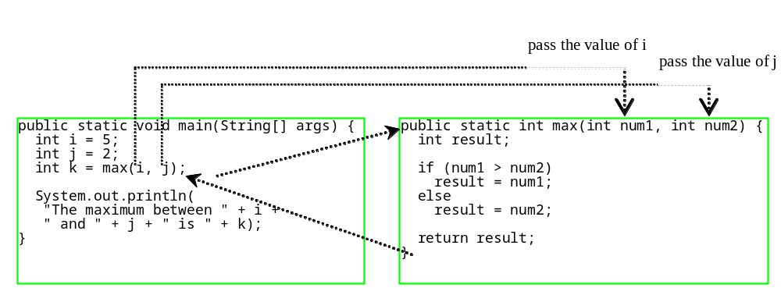
Calling Methods, cont.
animation

Slide 13

Trace Method Invocation
animation
i is now 5

Slide 14
Trace Method Invocation
animation
j is now 2

Slide 15
Trace Method Invocation
animation
invoke max(i, j)

Slide 16
Trace Method Invocation
animation
invoke max(i, j)
Pass the value of i to num1
Pass the value of j to num2

Slide 17
Trace Method Invocation
animation
declare variable result

Slide 18
Trace Method Invocation
animation
(num1 > num2) is true since num1 is 5 and num2 is 2

Slide 19
Trace Method Invocation
animation
result is now 5

Slide 20
Trace Method Invocation
animation
return result, which is 5

Slide 21
Trace Method Invocation
animation
return max(i, j) and assign the return value to k

Slide 22
Trace Method Invocation
animation
Execute the print statement

Slide 23

CAUTION
A return statement is required for a value-returning method. The method shown below in (a) is logically correct, but it has a compilation error because the Java compiler thinks it possible that this method does not return any value.
To fix this problem, delete if (n < 0) in (a), so that the compiler will see a return statement to be reached regardless of how the if statement is evaluated.

Slide 24
Reuse Methods from Other Classes
NOTE: One of the benefits of methods is for reuse. The max method can be invoked from any class besides TestMax. If you create a new class Test, you can invoke the max method using ClassName.methodName (e.g., TestMax.max).

Slide 25
void Method Example
This type of method does not return a value. The method performs some actions.
TestVoidMethod

Slide 26
Passing Parameters
public static void nPrintln(String message, int n) {
for (int i = 0; i < n; i++)
System.out.println(message);
}
Suppose you invoke the method using
  nPrintln(“Welcome to Java”, 5);
What is the output?
Suppose you invoke the method using
  nPrintln(“Computer Science”, 15);
What is the output?

Slide 27
Pass by Value
This program demonstrates passing values to the methods.
Increment

Slide 28
Pass by Value
Testing Pass by value
This program demonstrates passing values to the methods.
TestPassByValue

Slide 29
Overloading Methods
Overloading the max Method
public static double max(double num1, double num2) {
if (num1 > num2)
return num1;
else
return num2;
}
TestMethodOverloading

Slide 30
Ambiguous Invocation
Sometimes there may be two or more possible matches for an invocation of a method, but the compiler cannot determine the most specific match. This is referred to as ambiguous invocation. Ambiguous invocation is a compilation error.

Slide 31
Ambiguous Invocation
public class AmbiguousOverloading {
public static void main(String[] args) {
System.out.println(max(1, 2));
}
public static double max(int num1, double num2) {
if (num1 > num2)
return num1;
else
return num2;
}
public static double max(double num1, int num2) {
if (num1 > num2)
return num1;
else
return num2;
}
}

Slide 32
Scope of Local Variables
A local variable: a variable defined inside a method.
Scope: the part of the program where the variable can be referenced.
The scope of a local variable starts from its declaration and continues to the end of the block that contains the variable. A local variable must be declared before it can be used.

Slide 33

Scope of Local Variables, cont.
A variable declared in the initial action part of a for loop header has its scope in the entire loop. But a variable declared inside a for loop body has its scope limited in the loop body from its declaration and to the end of the block that contains the variable.

Slide 34

Scope of Local Variables, cont.

Slide 35

Method Abstraction
You can think of the method body as a black box that contains the detailed implementation for the method.

Slide 36
Benefits of Methods
Write a method once and reuse it anywhere.
Information hiding. Hide the implementation from the user.
Reduce complexity.

Slide 37
The Math Class
Class constants:
  PI
  E
Class methods:
  Trigonometric Methods
  Exponent Methods
  Rounding Methods
  min, max, abs, and random Methods

Slide 38
Trigonometric Methods
sin(double a)
cos(double a)
tan(double a)
acos(double a)
asin(double a)
atan(double a)
Examples:
Math.sin(0) returns 0.0
Math.sin(Math.PI / 6) returns 0.5
Math.sin(Math.PI / 2) returns 1.0
Math.cos(0) returns 1.0
Math.cos(Math.PI / 6) returns 0.866
Math.cos(Math.PI / 2) returns 0
Radians
toRadians(90)

Slide 39
Exponent Methods
exp(double a)
  Returns e raised to the power of a.
log(double a)
  Returns the natural logarithm of a.
log10(double a)
  Returns the 10-based logarithm of a.
pow(double a, double b)
  Returns a raised to the power of b.
sqrt(double a)
  Returns the square root of a.
Examples:
Math.exp(1) returns 2.71
Math.log(2.71) returns 1.0
Math.pow(2, 3) returns 8.0
Math.pow(3, 2) returns 9.0
Math.pow(3.5, 2.5) returns 22.91765
Math.sqrt(4) returns 2.0
Math.sqrt(10.5) returns 3.24

Slide 40
Rounding Methods
double ceil(double x)
  x rounded up to its nearest integer. This integer is returned as a double value.
double floor(double x)
  x is rounded down to its nearest integer. This integer is returned as a double value.
int round(float x)
long round(double x)

Slide 41
Rounding Methods Examples
Math.ceil(2.1) returns 3.0
Math.ceil(2.0) returns 2.0
Math.ceil(-2.0) returns –2.0
Math.ceil(-2.1) returns -2.0
Math.floor(2.1) returns 2.0
Math.floor(2.0) returns 2.0
Math.floor(-2.0) returns –2.0
Math.floor(-2.1) returns -3.0
Math.round(2.6f) returns 3
Math.round(2.0) returns 2
Math.round(-2.0f) returns -2
Math.round(-2.6) returns -3

Slide 42
min, max, and abs
max(a, b)and min(a, b)
  Returns the maximum or minimum of two parameters.
abs(a)
  Returns the absolute value of the parameter.
random()
  Returns a random double value
  in the range [0.0, 1.0).
Examples:
Math.max(2, 3) returns 3
Math.max(2.5, 3) returns 3.0
Math.min(2.5, 3.6) returns 2.5
Math.abs(-2) returns 2
Math.abs(-2.1) returns 2.1

Slide 43

The random Method
Generates a random double value greater than or equal to 0.0 and less than 1.0 (0 <= Math.random() < 1.0).
Examples:
In general,

